Slide 1
Title: The Big Idea of Optimizing Sales & Profitability in Superstore
Course : Data Visualization
Your Name: Yasoda Rana
18\Feb\2025

Slide 2
Introduction
Problem: Sales Fluctuations and Region Impacts
Goal: Use data to boost Sales, Profit, and Cutomer loyalty.
Primary Audience:
1. Consumer
2. Coporate
3. Home Office

Slide 3
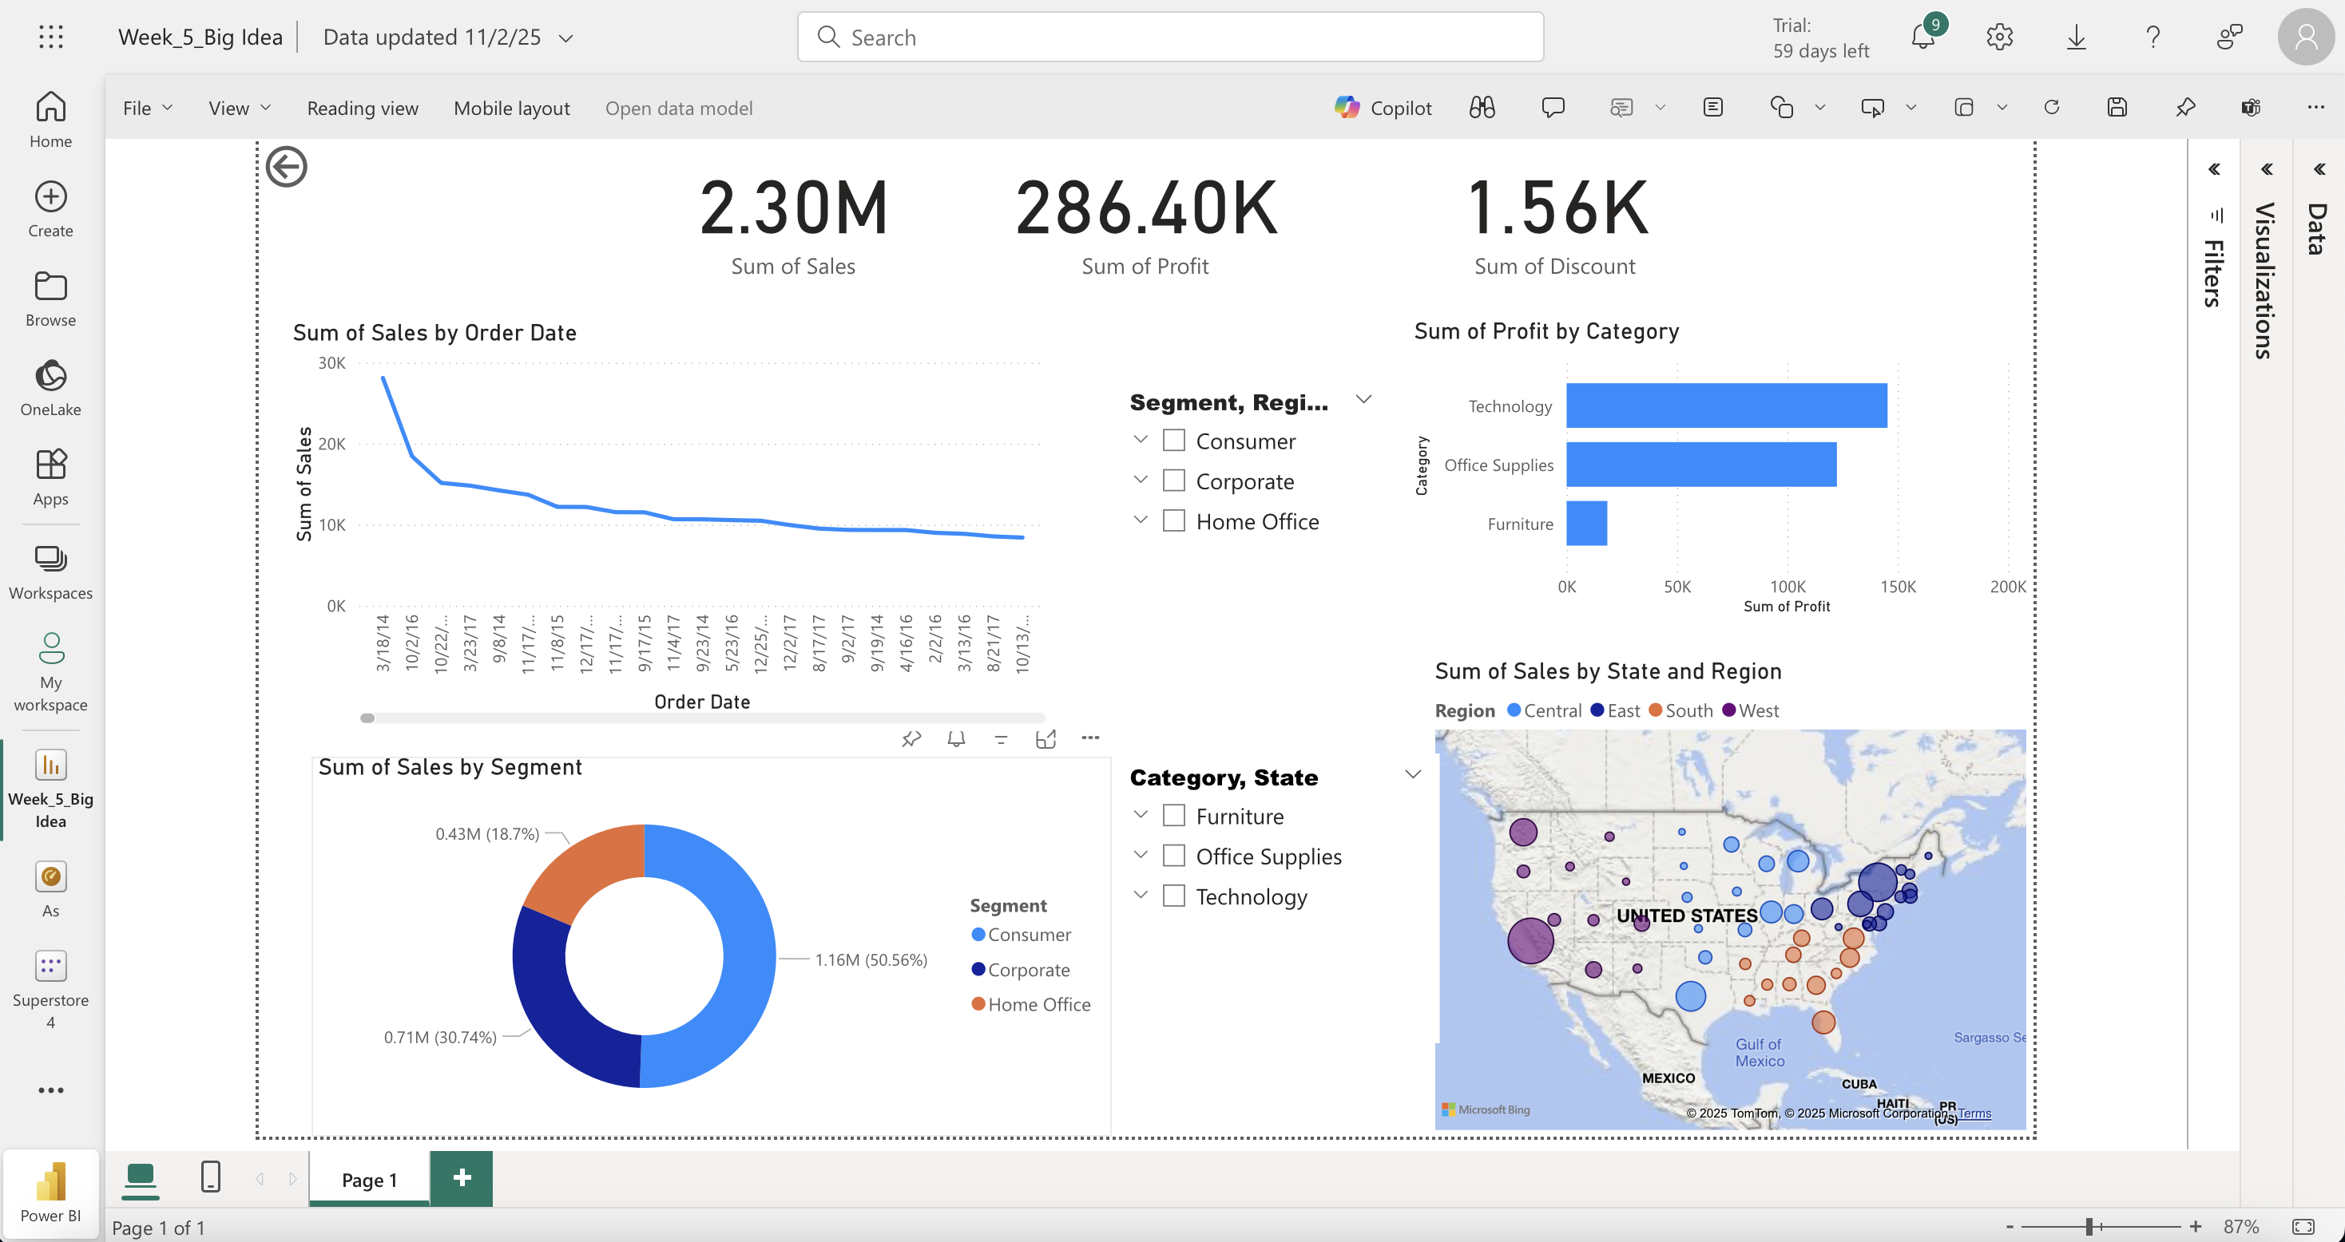
Dashborad
Key Metrics: Sales, Profit, Customer Segments, Product Performance, Regional Impact, Discount.

Slide 4
Key Insights
Top Products: Technology has the highest profit.
Customer Segments: Corporate clients spend the most.
Regional Trends: The West performs best; South has potential.
These Following helps to make a Strategic Decision

Slide 5
Choose: Coprorate Client
For Example: Micheal
Higher Sales Volume
Bigger Impact on Profitability
Long-Term
Business Relationships
Efficiency in Order Processing

Slide 6
Lower sales and profit.
Unsold inventory causing losses.
"Taking action now prevents these risks."
Risks of Inaction

Slide 7

        Thank you

